Slide 1
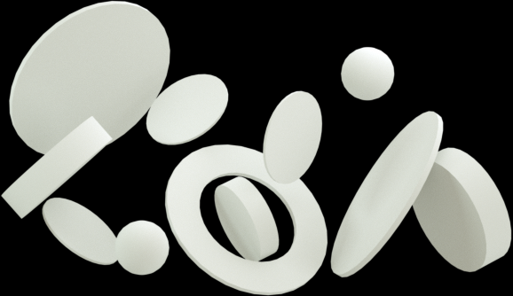


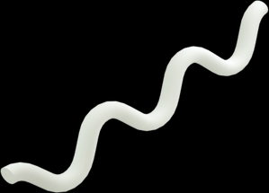


Novel Visualisation Methods for Data Analytics and Machine Learning
Brought to you by: MLDA
Ho Chi | Hui Xiang

Slide 2


Participate!
https://www.wooclap.com/MLDAVIZ

Slide 3

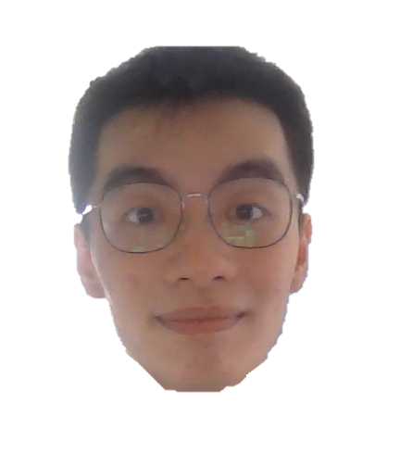
Ho Chi
Hui Xiang
CS Year 1
linkedin.com/in/nghochi/
REP Year 1
linkedin.com/in/hui-xiang/

Slide 4

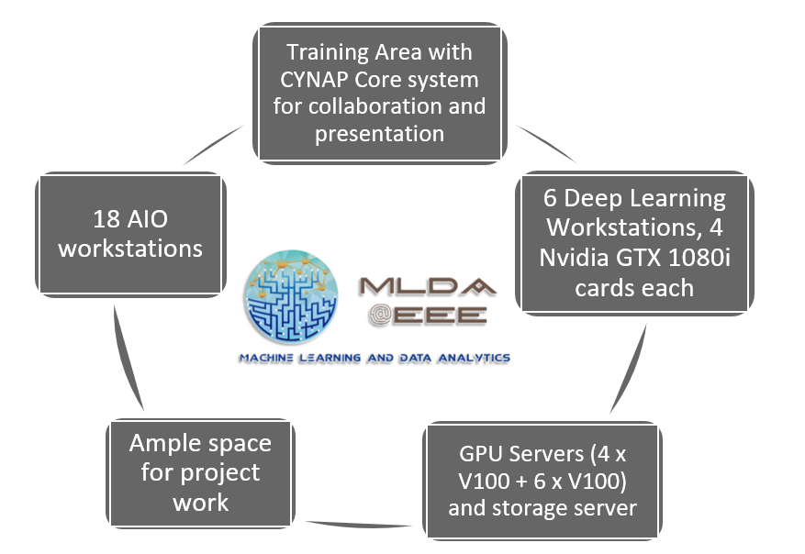
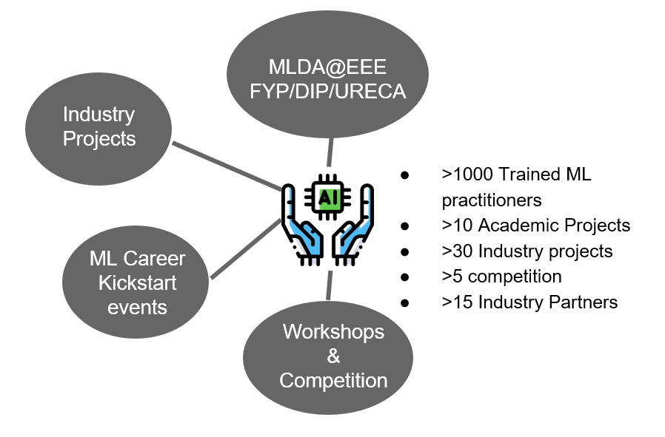
Our Mission:
Provide an integrated platform for NTU students to learn and implement Machine Learning, Data Science & AI, as well as facilitate connections with the industry

Slide 5
Our Mission:
Provide an integrated platform for NTU students to learn and implement Machine Learning, Data Science & AI, as well as facilitate connections with the industry

Slide 6
Agenda.

Slide 7
Agenda.

Slide 8

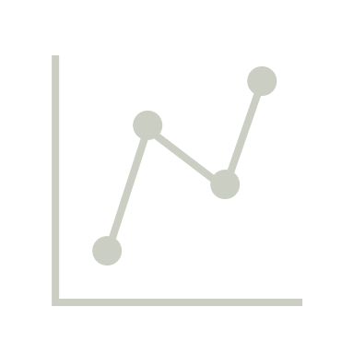


Why Visualise?
Data Analytics Tools
Machine Learning Tools
Hands-On
Agenda.

Slide 9

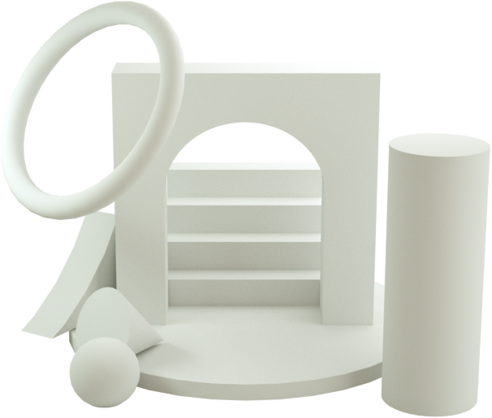
• Pre-requisites •
Python programming knowledge
A basic understanding of the Pandas library
A basic understanding of machine learning (Minimal knowledge in PyTorch / Tensorflow)

Slide 10
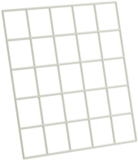
• Takeaways •
Common and novel libraries to visualise dataframes (Interactive and Beautiful!)
Machine Learning Model and Training Visualisation Methods

Slide 11
Why Visualise?
Data Analytics Tools
Machine Learning Tools
Hands-On
Agenda.

Slide 12
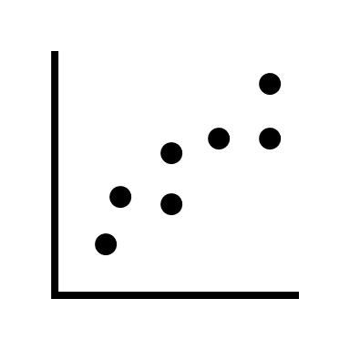
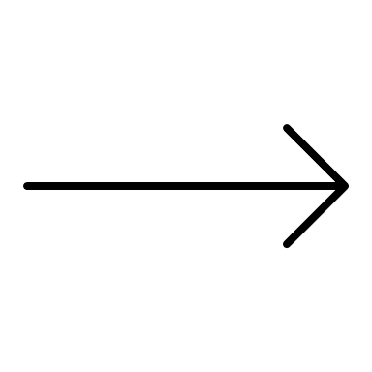
x | y
1 | 1
1.2 | 2
2.2 | 1.8
2.2 | 2.8
3.2 | 3
4.2 | 3
4.2 | 4.1
1. Helps us express our ideas better, better convincing power

Slide 13
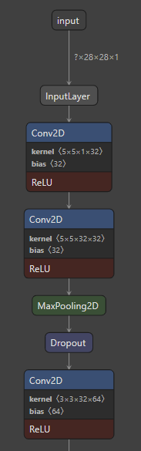
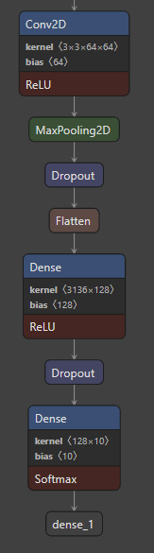
model = tf.keras.models.Sequential([
tf.keras.layers.Conv2D(32, (5,5), padding='same', activation='relu’, \
input_shape=(28,28,1)),
tf.keras.layers.Conv2D(32, (5,5), padding='same', activation='relu'),
tf.keras.layers.MaxPool2D(),
tf.keras.layers.Dropout(0.25),
tf.keras.layers.Conv2D(64, (3,3), padding='same', activation='relu'),
tf.keras.layers.Conv2D(64, (3,3), padding='same', activation='relu'),
tf.keras.layers.MaxPool2D(strides=(2,2)),
tf.keras.layers.Dropout(0.25),
tf.keras.layers.Flatten(),
tf.keras.layers.Dense(128, activation='relu'),
tf.keras.layers.Dropout(0.5),
tf.keras.layers.Dense(num_classes, activation='softmax')
])
???
2. Helps us understand our model and data better

Slide 14
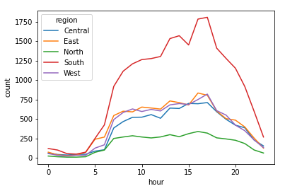
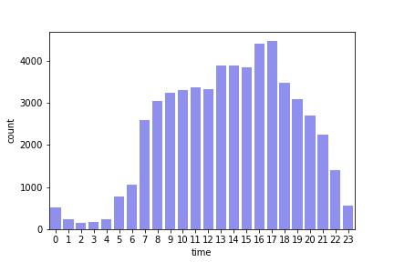
3. It Just Looks Nice!

Slide 15
Why Visualise?
Data Analytics Tools
Machine Learning Tools
Hands-On
Agenda.

Slide 16


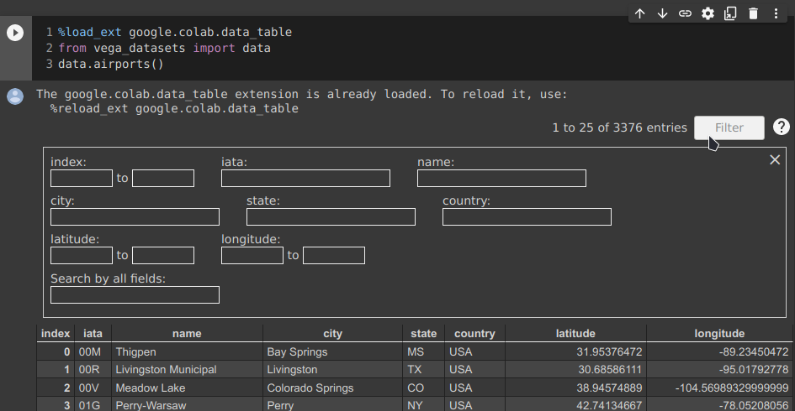



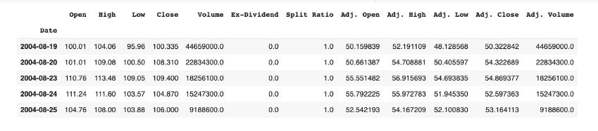
Google Colab Data Tables
Pandas Dataframe
Google Colab Data Tables
PandasGUI

Slide 17
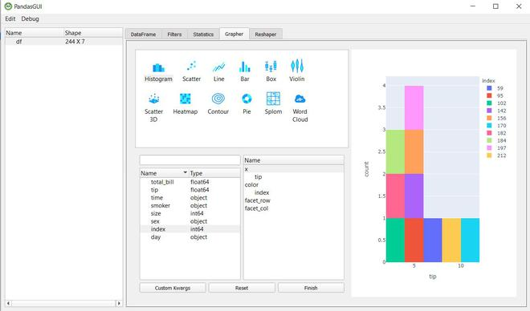
PandasGUI
Google Colab Data Tables
PandasGUI

Slide 18
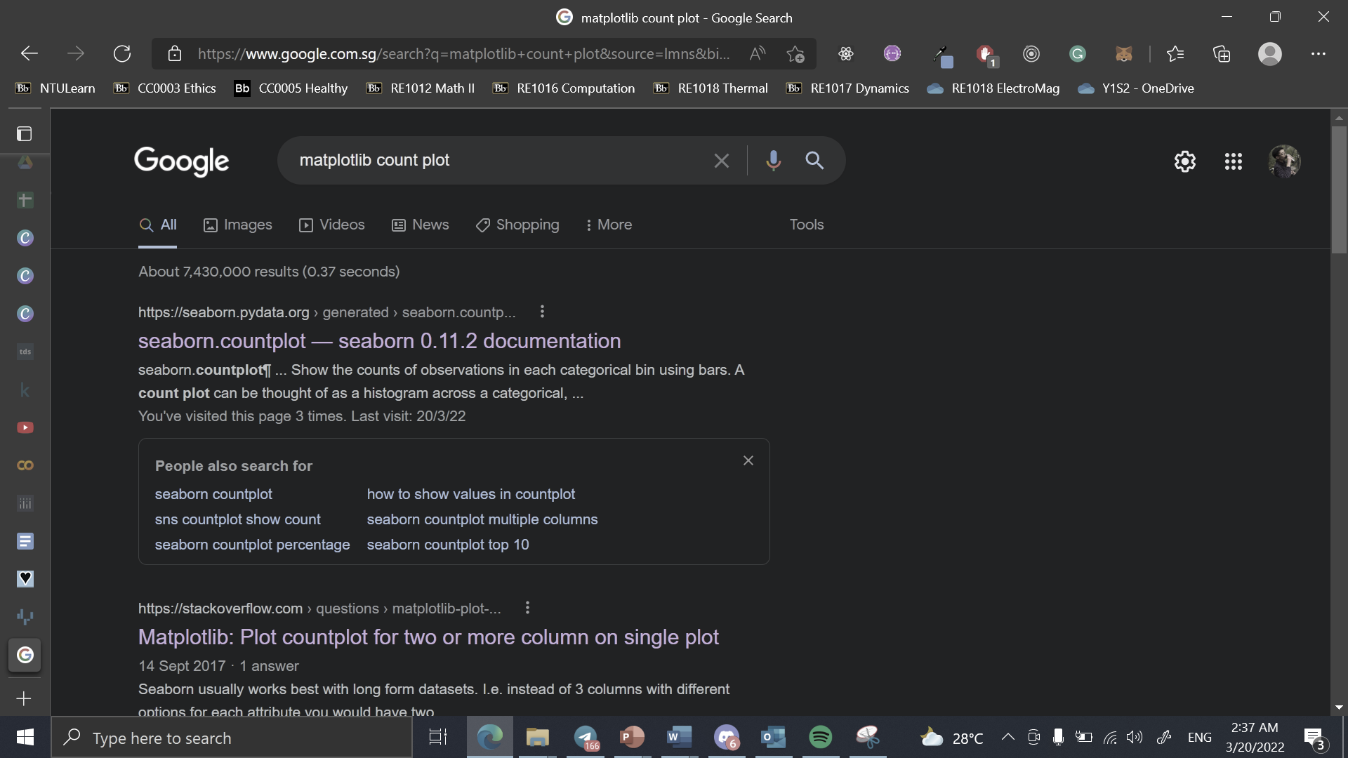


✓ More customizability over plot design
✗ Harder to achieve aesthetic niceness
✓ Easier to achieve aesthetic niceness
✓ Easier to plot
Sufficient for 80-90% of use cases if used well

Slide 19
✓ More customizability over plot design
✗ Harder to achieve aesthetic niceness
✓ Easier to achieve aesthetic niceness
✓ Easier to plot
Sufficient for 80-90% of use cases if used well

Slide 20
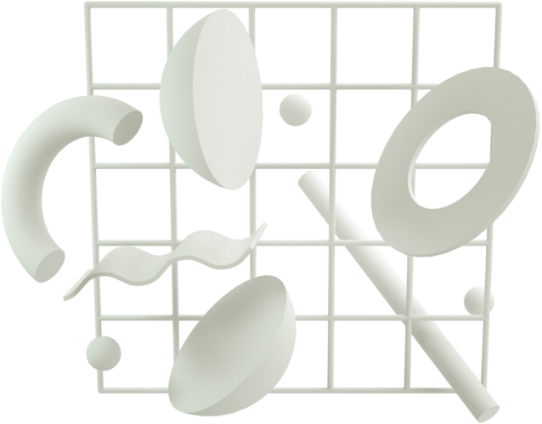
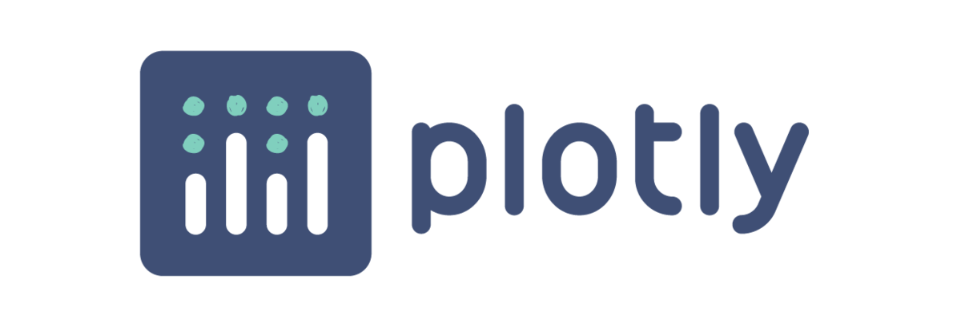


Interactive Charts!

Slide 21
Geospatial Data?
Interactive Charts!
Maps?

Slide 22



Geospatial Data?
More Coding 😭
Folium
Kepler.gl
More Configuration 🤬
Maps?

Slide 23
Geospatial Data?
More Coding 😭
Folium
…
Kepler.gl
More Configuration 🤬
Maps?

Slide 24
Why Visualise?
Data Analytics Tools
Machine Learning Tools
Hands-On
Agenda.

Slide 25
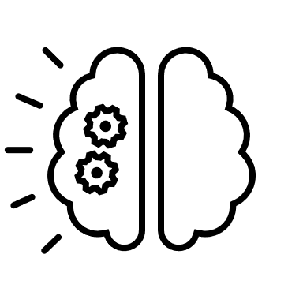
Machine Learning Tools
Model Visualisation
Training
Visualisation

Slide 26


Model Visualisation

Slide 27

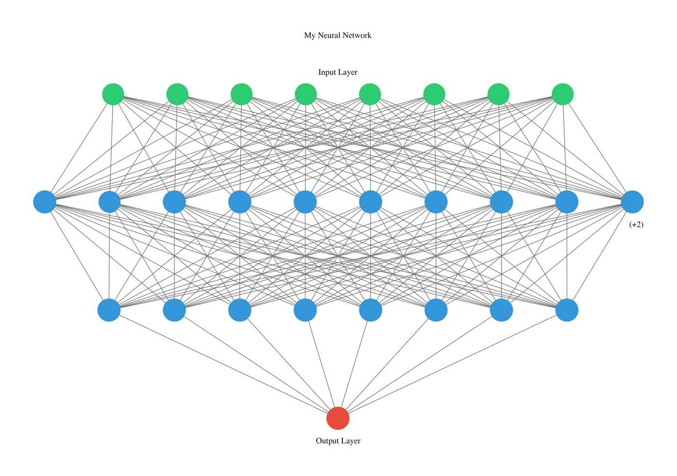
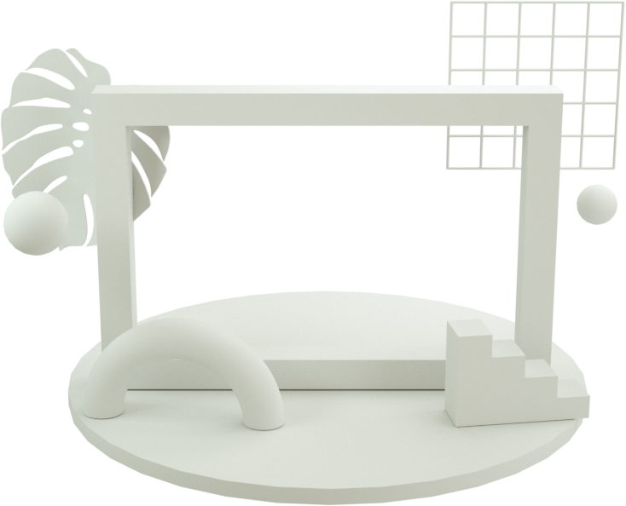
Model Visualisation
Allows for neural network visualisation, with connections between layers and interactivity
Has an online app as well where you can upload your model

Slide 28

Model Visualisation
Allows for neural network visualisation, with connections between layers
Super simple to set up

Slide 29
Machine Learning Tools
Model Visualisation
Training
Visualisation

Slide 30

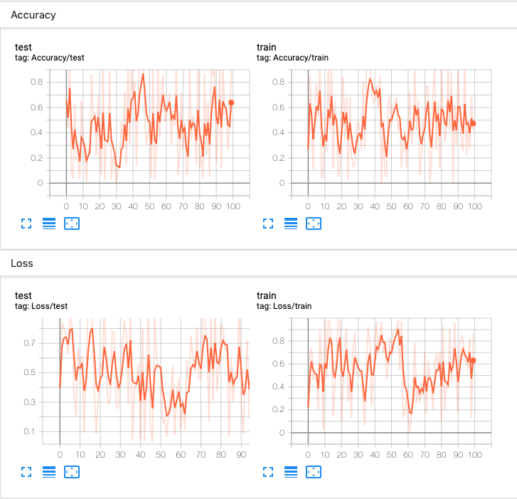
Training Visualisation

Slide 31
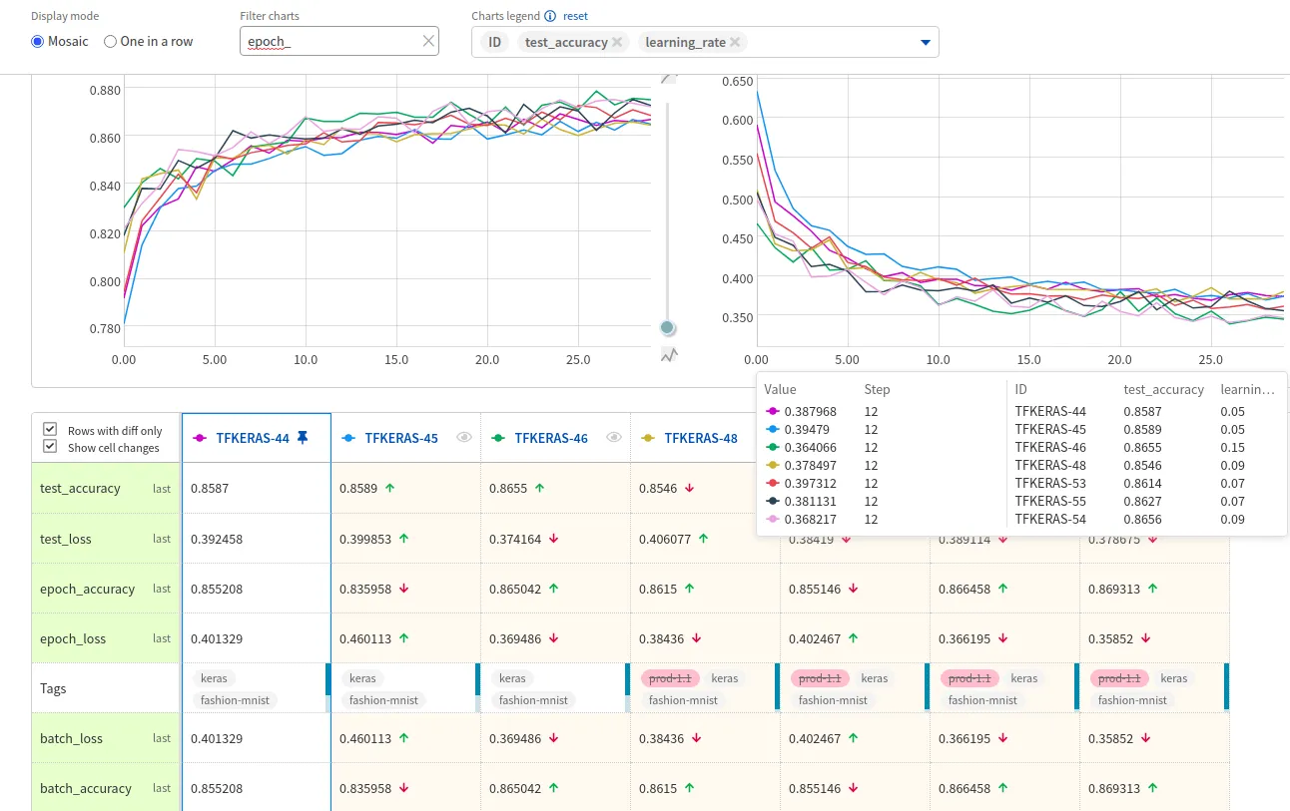
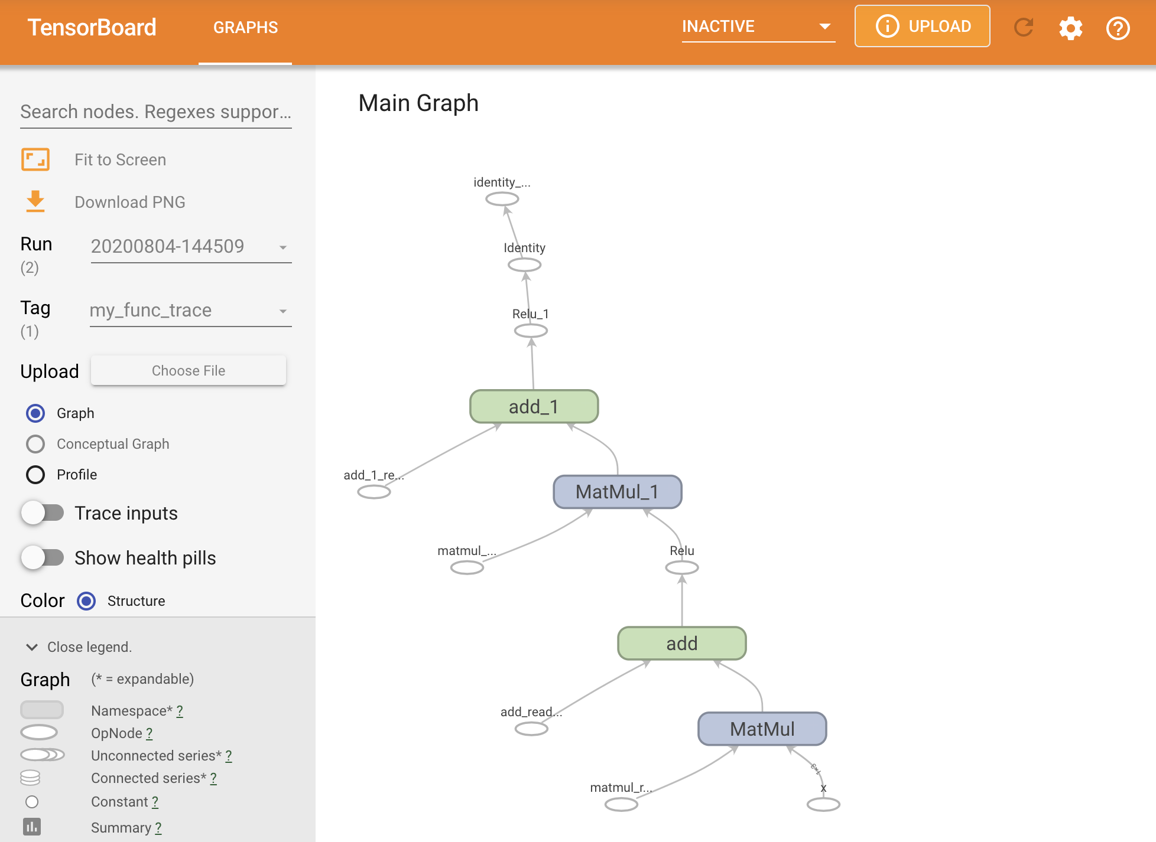
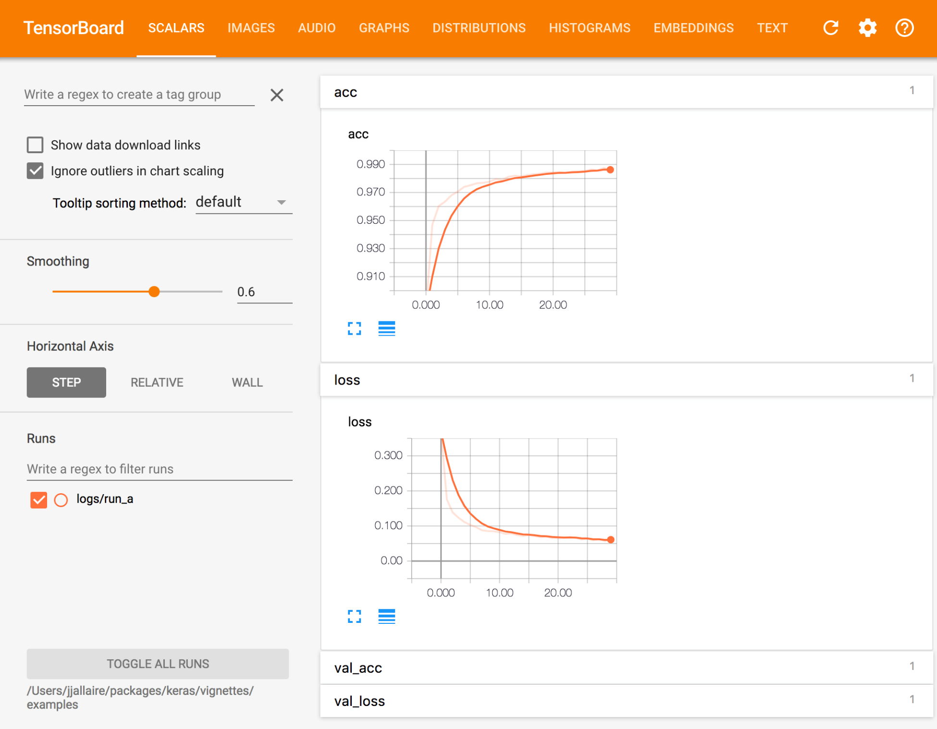
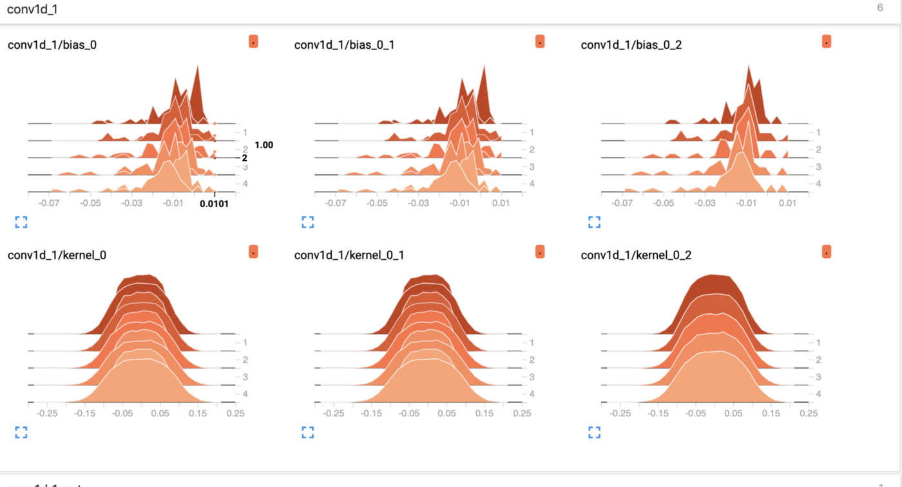
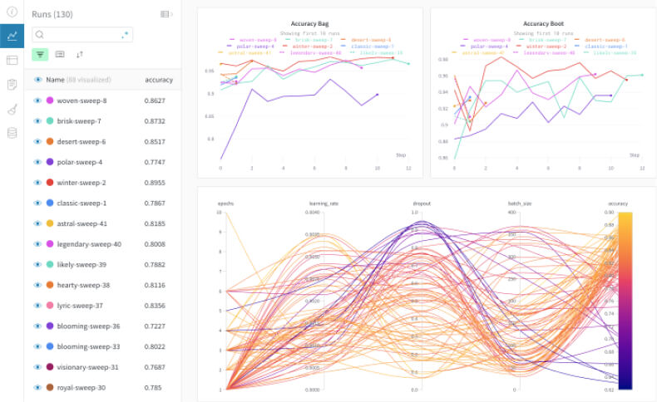
Training Visualisation
Allows you to inspect and understand machine learning runs and graphs
Can see how weights* change over time
*Weight is the parameter within a neural network that transforms input data within the network's hidden layers

Slide 32

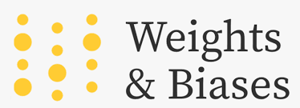
Training Visualisation
*Weight is the parameter within a neural network that transforms input data within the network's hidden layers

Slide 33
Data Analytics Tools
Machine Learning Tools
Colab Data Tables
PandasGUI
Matplotlib
Seaborn
Plotly
Altair
Bokeh
Folium
Kepler.gl
Data
Visualisation
Netron
ANN Visualizer
Tensorboard
Neptune.ai
WandB
Model Visualisation
Training Visualisation
Graphs & Charts
Geospatial
Data

Slide 34
Data Analytics Tools
Machine Learning Tools
Colab Data Tables
PandasGUI
Matplotlib
Seaborn
Plotly
Altair
Bokeh
Folium
Kepler.gl
Data
Visualisation
Netron
ANN Visualizer
Tensorboard
Neptune.ai
WandB
Model Visualisation
Training Visualisation
Graphs & Charts
Geospatial
Data

Slide 35
B r e a k
15mins break! If you have any questions so far, feel free to submit them on the wooclap!

Slide 36
Why Visualise?
Data Analytics Tools
Machine Learning Tools
Hands-On
Agenda.

Slide 37

Hands-On
https://bit.ly/3NyjBoa

Slide 38

Post Workshop Survey!
https://bit.ly/3wlCbJP

Slide 39
Ending Off 😢
https://bit.ly/3wlCbJP
Thank you for your participation in this workshop and hope you have enjoyed it.
Please fill in the workshop’s feedback form for new and improved workshops in the future!
All rights reserved to their respective owners and this workshop is solely for learning purposes.
Should you have any further questions or would like to voice out any errors in the materials, do feel free to reach out via chay0022@e.ntu.edu.sg / c210142@e.ntu.edu.sg.

Slide 40
Ho Chi
Hui Xiang
Thank you! 🤩
https://bit.ly/3wlCbJP

